Slide 1
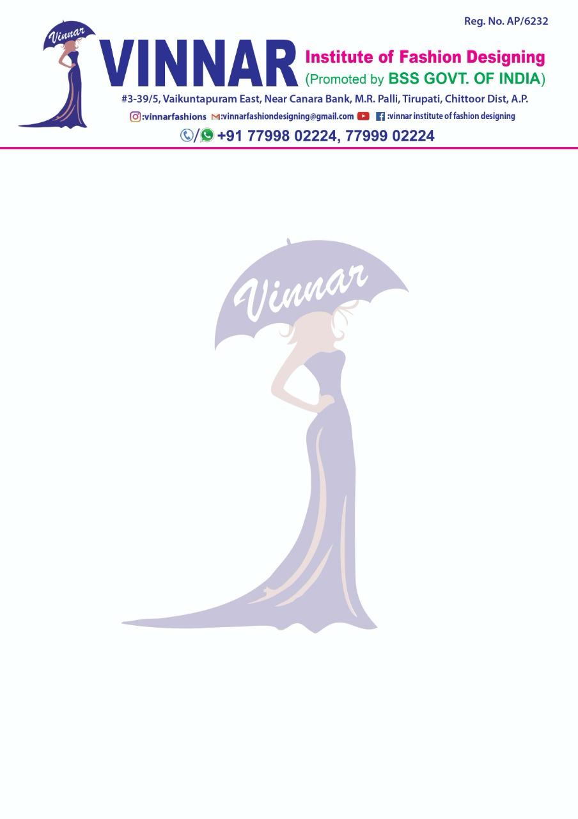
Student Name: Batch Name:
Registration No: Year:
1 YEAR COURSE FASHION ILLUSRATION
S.NO | TOPIC NAMES | COMPLETED DATE | SUBMISSSION DATE | REMARKS
1 | Lines and curves
2 | Shape and Form 2D,3D
3 | Space (P , N , M)
4 | Value Shading
5 | Pointing and shading techniques
6 | Enlargement and reduction
7 | Textures
8 | Color wheel
9 | Types of color wheel
10 | Value
11 | Tint , tone , shade techniques
12 | Warm and cool colors
13 | Color schemes ( mono & achromatic)
14 | Principle of designs

Slide 2
15 | Rendering stroke techniques
16 | Variation of single motif
17 | 6 types of Repeats
 | 10 HEAD FASHION CROQUIS
18 | Types of Accessories and garment sillouts sketching
19 | 10 head block figure
20 | Flesh figure
21 | Front and back pose
22 | Hand movements
23 | 6 types of movement poses
24 | Skin tone rendering
25 | Casual wear
26 | Formal wear
27 | Western wear
28 | Indo western wear
29 | Ethnic wear
30 | Traditional wear
31 | Stylized figures
32 | Beach wear

Slide 3
Student Name: Batch Name:
Registration No: Year:
1 YEAR COURSE PATTERN MAKING
S.NO | TOPIC NAMES | COMPLETED DATE | SUBMISSSION DATE | REMARKS
1 | Basic seems
2 | Hand seems
 | KIDS - garments
3 | Kids kurthi
4 | Kids long frock
5 | Kids lehanga
6 | Kids Jump suit
 | WOMENS - GARMENTS
7 | Kurthi 1 -
8 | Kurthi 2 -
9 | Kurthi 3 -
10 | Kurthi 4 -

Slide 4
11 | Long frock 1 -
12 | Long frock 2 -
13 | Long frock 3 -
14 | Long frock 4 -
15 | Skirt 1 -
16 | Skirt 2 -
17 | Skirt 3 -
18 | Blouse 1 -
19 | Blouse 2 -
20 | Blouse 3 -
21 | Blouse 4 -
22 | Blouse 5 -
23 | Blouse 6 -
24 | Blouse 7 -
25 | Pant 1- Trouser
26 | Pant 2- Patiala
27 | Pant 3- Palazzo
28 | Pant 4- Straight cut
29 | Pant 5- Kali pant
30 | Long shrug

Slide 5
Student Name: Batch Name:
Registration No: Year:
1 YEAR COURSE EMBROIDERY
S.NO | TOPIC NAMES | COMPLETED DATE | SUBMISSSION DATE | REMARKS
1 | Running stitch
2 | Back stitch
3 | Running wipped
4 | Split stitch
5 | Stem stitch
6 | Chain stitch
7 | Blanket stitch
8 | Herring bone stitch
9 | Fly stitch
10 | Cable stitch
11 | Sat in stitch
12 | Pistil stitch
13 | Crown stitch
14 | Lazy daisy stitch

Slide 6
15 | Reverse chain stitch
16 | French knot stitch
17 | Fern stitch
18 | Fish bone stitch
19 | Flower design stitch
20 | Basket stitch
21 | Seed stitch
22 | Twist chain stitch
23 | Wave stitch
24 | Woven rose stitch
25 | Long and short stitch
26 | Ponytail hairstyle
27 | French braid hairstyle
28 | Bun hairstyle
29 | French knot bun hairstyle
30 | Free hairstyle
31 | 5 types of smocking
32 | Applica work
34 | Basic Aari work
35 | Calendar art
36 | 5 types of Hairstyle with garment

Slide 7
Student Name: Batch Name:
Registration No: Year:
1 YEAR COURSE BEAUTICIAN
S.NO | TOPIC NAMES | COMPLETED DATE | SUBMISSSION DATE | REMARKS
1 | Threading
2 | Facial
3 | Hairstyle-1
4 | Hairstyle-2
5 | Hairstyle-3
6 | Hairstyle-4
7 | Hairstyle-5
8 | Saree draping-1
9 | Saree draping-2
10 | Saree pre pleating
11 | Make-up
12 | Flower making
13 | Mehandi

Slide 8
Student Name: Batch Name:
Registration No: Year:
1 YEAR COURSE SOFTWARE-ADOBE ILLUSTRATOR
S.NO | TOPIC NAMES | COMPLETED DATE | SUBMISSSION DATE | REMARKS
1 | Introduction to adobe illustrator
2 | Motif development
 | Vertical
 | Horizontal
 | Diagonal
3 | Rotate motif development
 | 2- Repeat
 | 4- Repeat
 | 8- Repeat
 | 12- Repeat
4 | All over repeat pattern
 | All over
 | Brick by row repeat
 | Ogee repeat
 | Toss repeat

Slide 9
5 | Clip masking method
6 | Flat sketches
 | Trouser
 | Shorts
 | Skirt
 | Blazer
7 | Garment spec-sheet
8 | Jewelry designing
 | Pearl effect
 | Sequence effect
9 | Business card
10 | Logo creation
11 | Garment Labels
12 | Garment patterns
13 | Body form garment creation

